Slide 1
The Carpenter Ants
Assignment 4

Slide 2
SafetyNet
Value Proposition:
The support you need, guilt-free.
Solution Overview:
Disabilities often lead to a sense of guilt in asking for help on a daily basis. In order to eliminate this feeling of a burden from the lives of those who need assistance, we introduce Safety Net, a help-request platform that leverages one's personal, trusted network to decentralize the asking process. Add friends, family, and trusted individuals to your entourage so that next time you need to ask the inevitable, you are supported by the ones you love. Your crew will be notified and see how helpful they’ve been to successfully distribute the deeds for you, leaving you to simply select helpers from your crew.
Notes:
(The value proposition should concisely convey what customers get out of your product in a short phrase (e.g., stripe.com “Payment infrastructure for the Internet”, evernote: “Remember everything!”)_
Possible names: benefriend, entourage, crew, auxi, uplift, hand, boost, alloy, safety net, Need a hand, supporters, catalyst, friendly hands
Possible value props:
Getting the support you need from your network
receiving help, removing the burden
Receiving trusted support, removing the burden
Empowering those through the masses
Getting you the support you need without the burden of reaching out.
Taking the guilt out of asking for help.
by distributing support amongst a network of trusted individuals.
connecting individuals to their support system

Slide 3
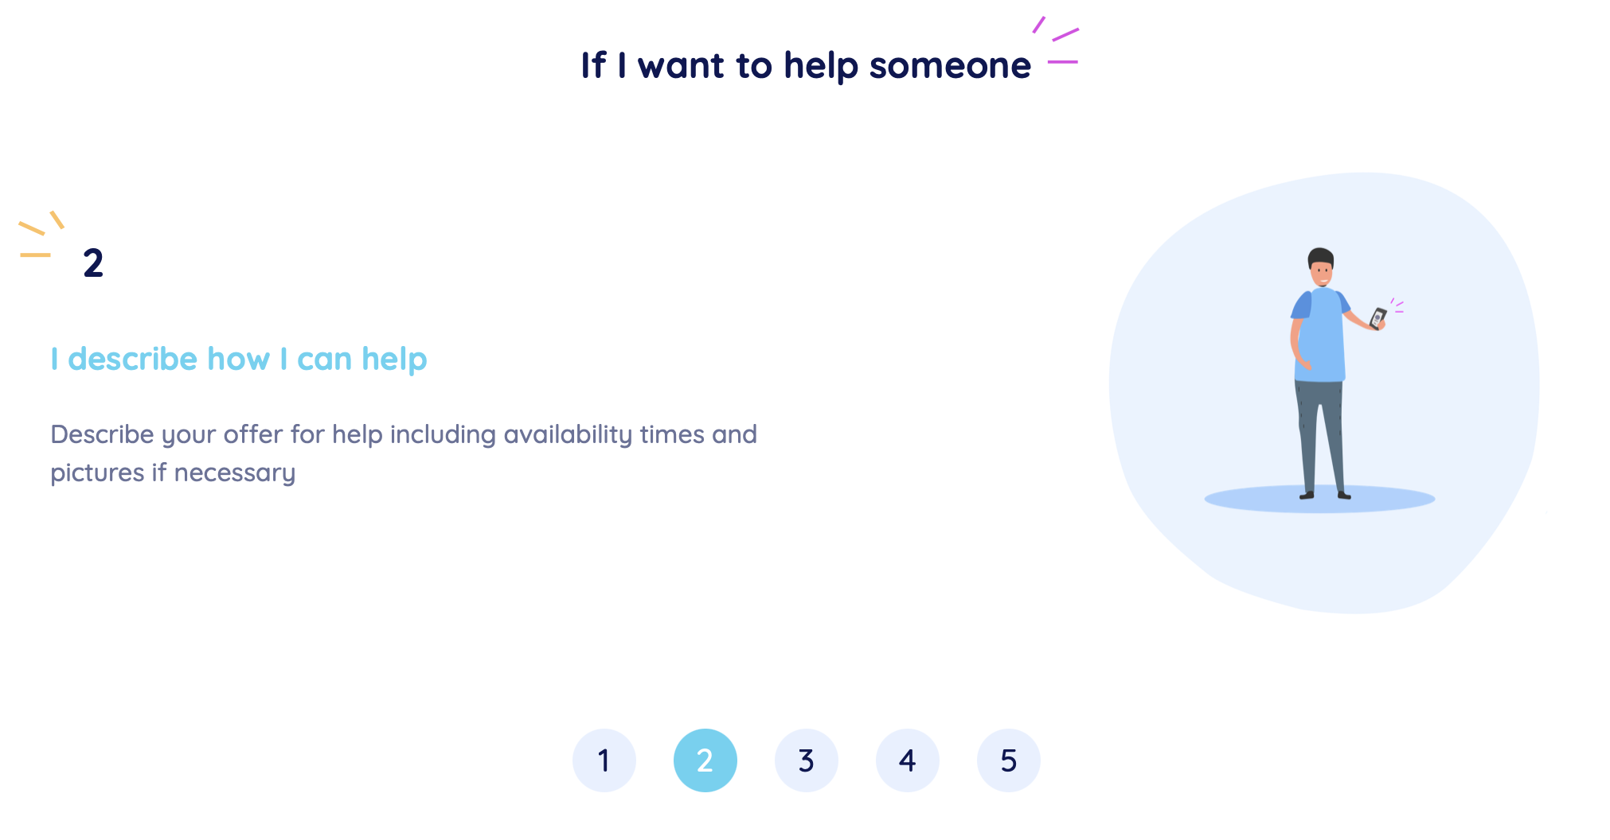
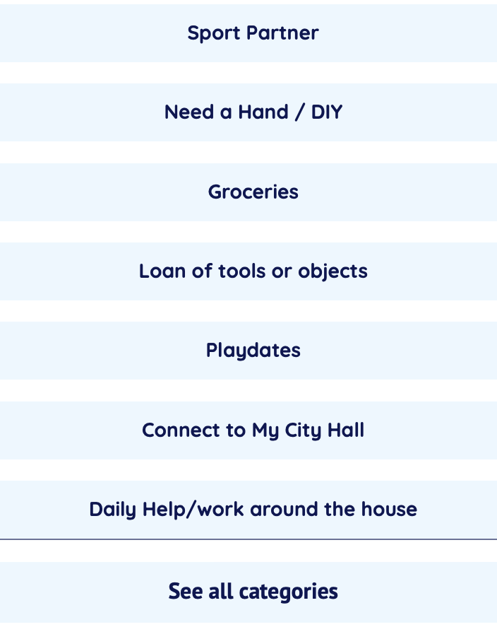
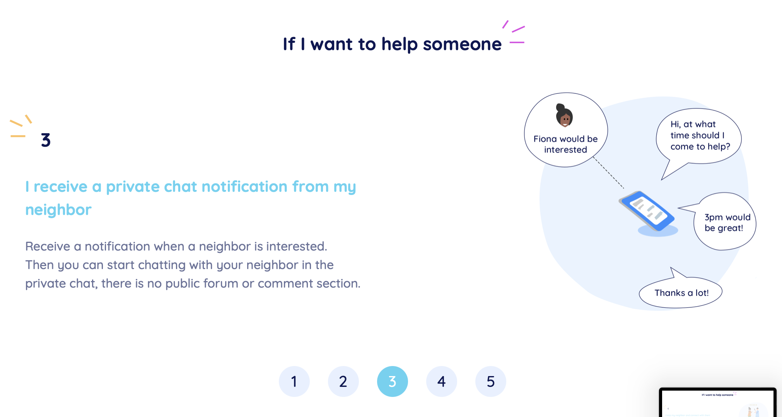
Market Research:
My Nabes
Differences:
My Nabes focuses on community building by location (street, neighborhood, nearby neighborhood) while Safety Net focuses on trusted relationships (family, close friends, etc.)
Allowing neighbors to offer help and requiring the individual to message them directly
Has/has not worked:
Has: Partnering with government officials so that neighbors can contact their city hall easily (we could do the same for medical professionals and other resources like hot-lines)
Has not: Doesn’t have a large community on the app yet, so the people on the app don’t have many neighbors to reach out to
We are unique:
We are focused on the guilt aspect of asking trusted friends for help. My Nabes misses our goal by offering spaces where the individual asking for help needs to private message people individually (as seen above). There are unique needs that people living with disabilities have—needing to ask trusted friends for help because their situations can be sensitive, feeling like a burden for always asking the same people, etc.—that My Nabes does not address, but Safety Net does.

Slide 4



Tasks
Complex: Finding a community for users without a strong local community or people to reach out to
Complex: Caretakers for users with more specialized needs being able to create needs for that user and send them out to the user’s community
Moderate: community viewing the need, assessing if they can help, and accepting or denying
Simple: sending a need out to the user’s community
Notes:
Capture the core tasks that your project enables. Together, they should capture the core value prop of your product and address the problem you’re tackling. Label them as simple, medium, and complex
Describe three to five tasks in moderate detail that users will perform with your top solution ideas. There should be at least one each of simple, moderate, and complex tasks. Note: tasks do not say how to carry out the activity, but instead say what the user is trying to achieve. Focus on user behavior, not features. Label each task as simple, moderate, or complex.

Slide 5
Values in Design
The four main values embedded in this project are Safety, Security, Ease of Mind, and Community Building. In order for us to be able to properly integrate these values in our app, we are going to provide a safe and secure method for our end users to ask for the help they need, directly from their immediately community (if they have one), to keep our users as safe as possible. For end users without a close community, we will put them in contact with local organizations to be able to still get the help they need. To us, providing our end users with Ease of Mind is giving them the ability to reach out for assistance when they need to, without feeling burdened by the guilt that often accompanies making frequent requests of your close community. Our network feature will largely contribute to our core value of Community Building, as community members collaborate to fulfill help requests, they will also enrich their local community, providing stronger bonds for everyone involved.
The only conflict in values that has presented itself to us at the moment is trying to balance building a robust community for our end-users, while also ensuring that they are safe and secure. Having users self-select their network allows us to build community among our users without risking their safety, but there is some factor, however small, of unavoidable risk for the users without a local community to be matched. We can mitigate this risk by thoroughly background checking any organization onboarded on the platform, to ensure that all of our users have the same safe and secure experience.

Slide 6
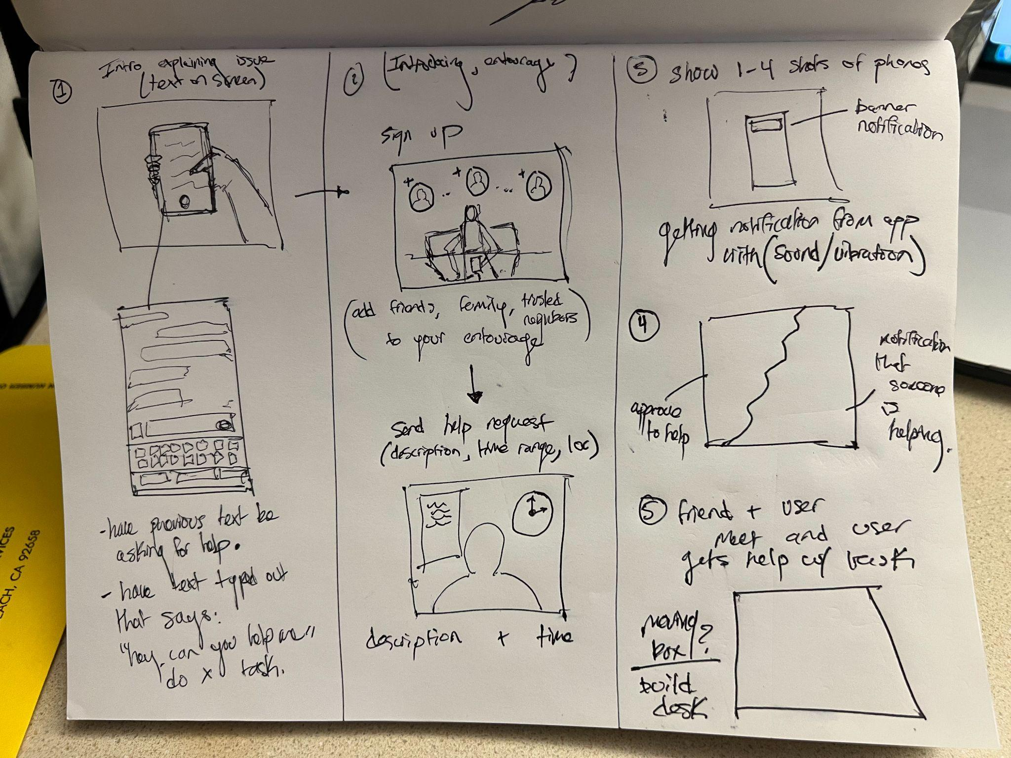
Storyboard 1

Slide 7
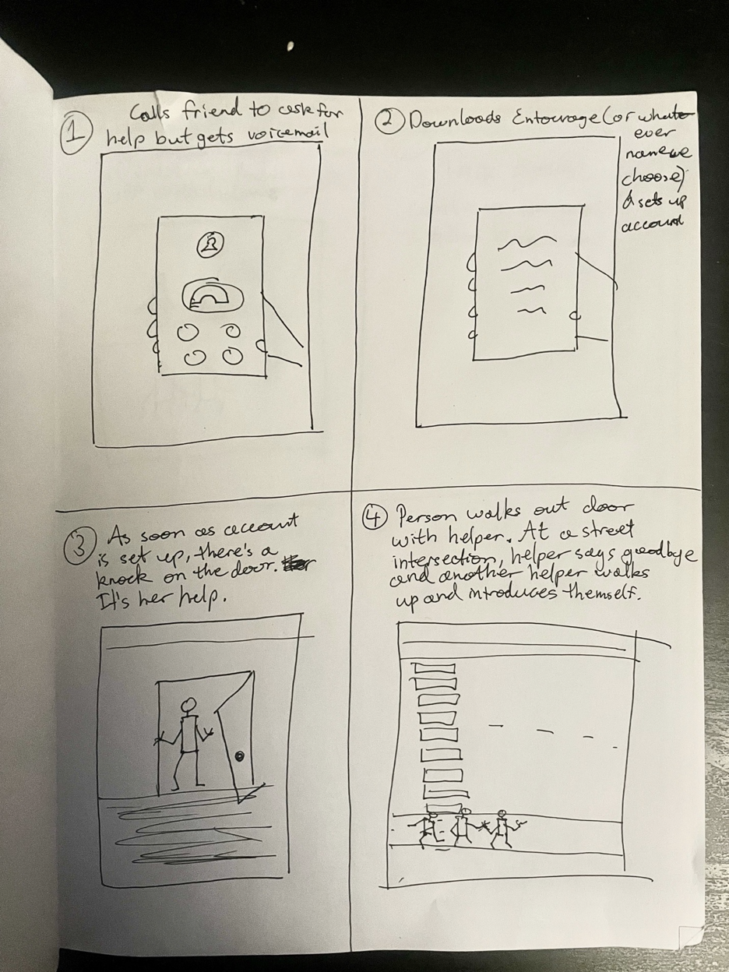
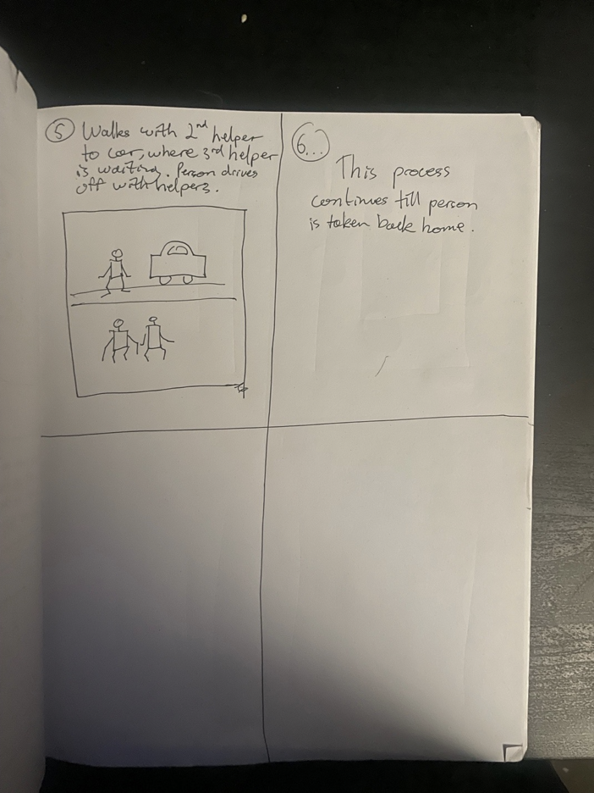
Storyboard 2

Slide 8
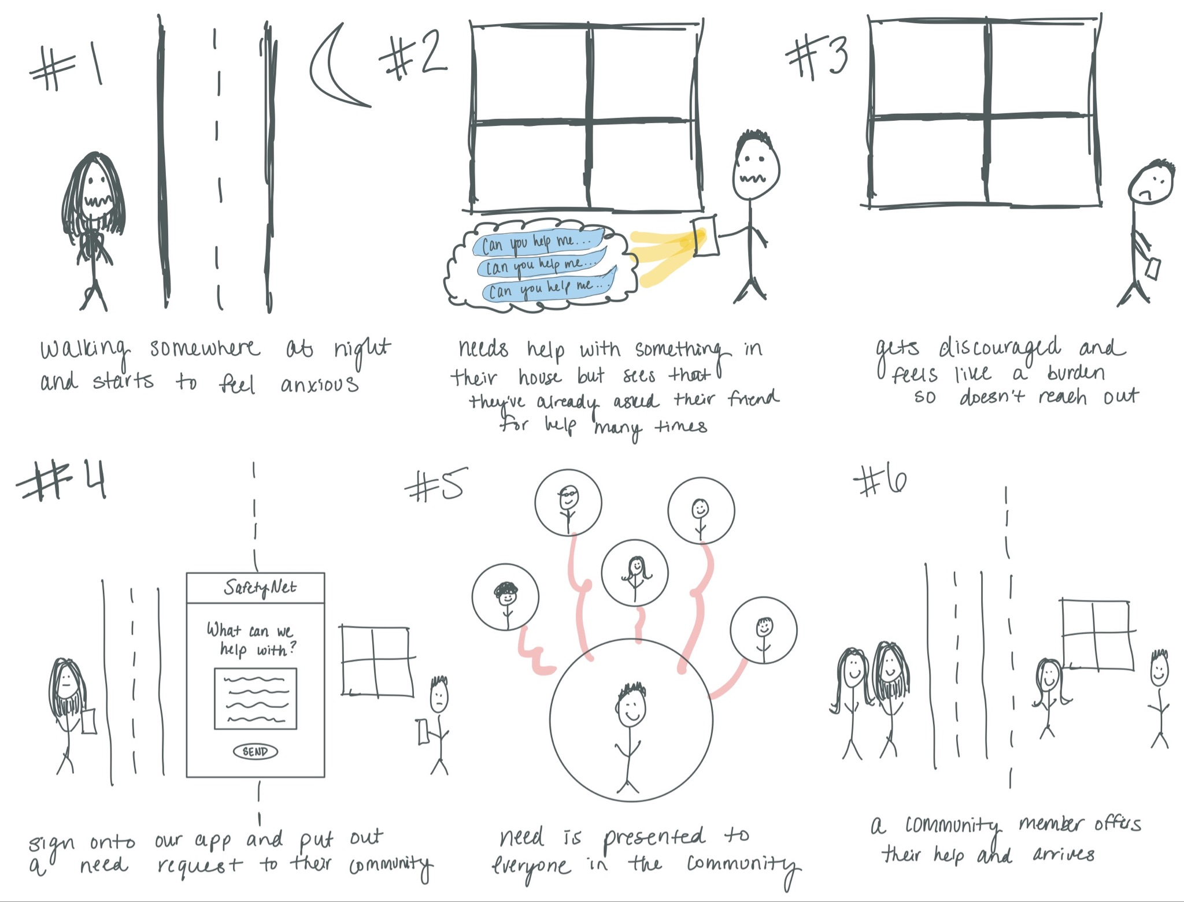
Storyboard 3

Slide 9
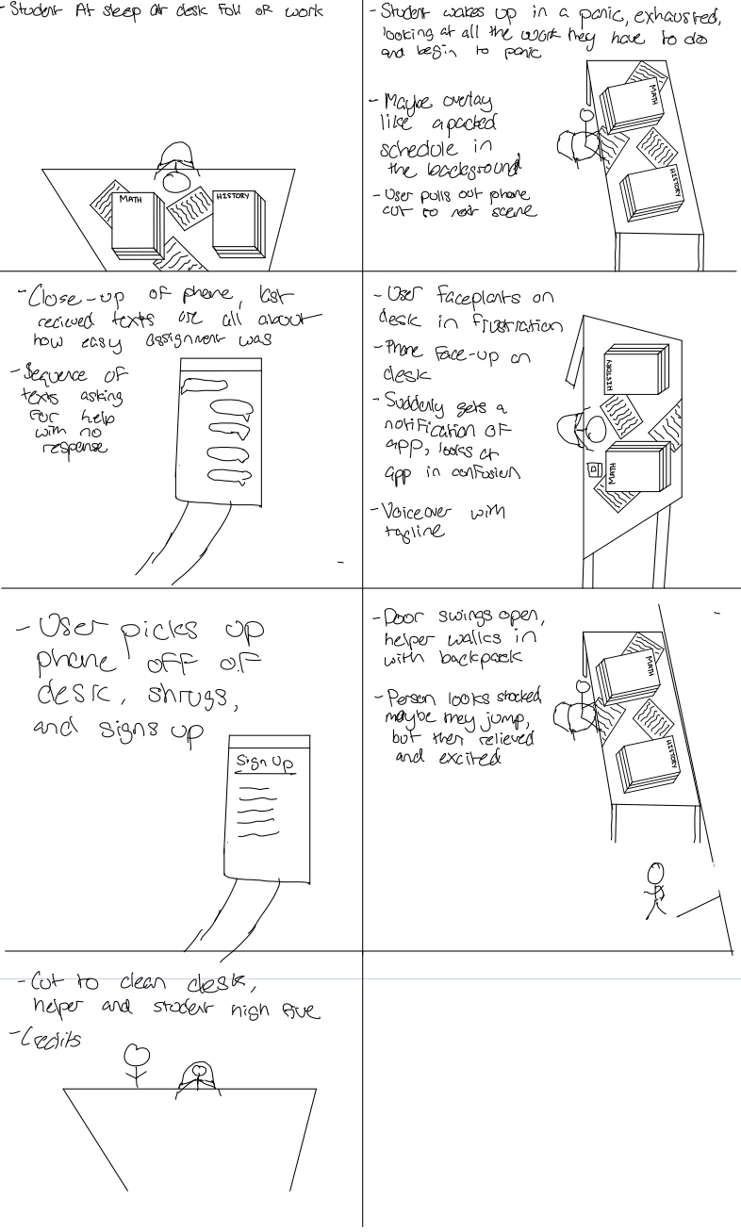
Storyboard 4

Slide 10
Video Link
https://youtu.be/-Z4Gzg2Ie-U

Slide 11
Thank You

